Slide 1
STOR 455 Class 4
Read: 1.1-1.4
Exercises: 1.27, 29abc, 31, 32abc

Slide 2
Single Quantitative Predictor Model
Notation: Y = Response variable
X = Predictor variable
Assume (for now) that both Y and X are quantitative variables.

Slide 3
Simple Linear Model
X = Single quantitative predictor
Y = Quantitative response
Find a line that best summarizes the trend in the data.
Y
X

Slide 4
Simple Linear Model
response
random error
Y = β_{o} + β₁X + ε
intercept
predictor
slope
Assume: ε ~ N( 0, σ_{ε}) and independent
Three parameters to estimate: β_{o}, β₁, σ_{ε}

Slide 5
Simple Linear Model- Conditions
Model:
Linearity: The means for Y vary as a linear function of X.
Error:
Zero Mean: The distribution of the errors is centered at zero.
Constant variance: The variance for Y is the same at each X. (Homoscedasticity)
Independence: No relationships among errors.
Normality:
Residuals are normally distributed
(sometimes) At each X, the Y’s follow a normal distribution.

Slide 6
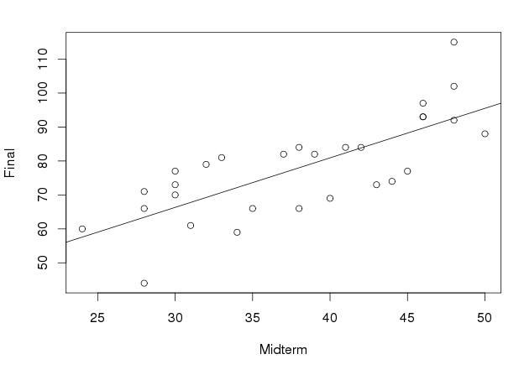
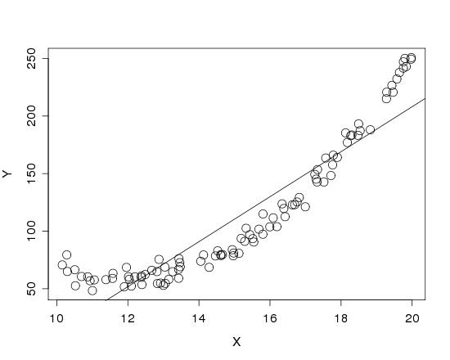


Is it Linear?
Look for consistent curvature or non-linear patterns

Slide 7
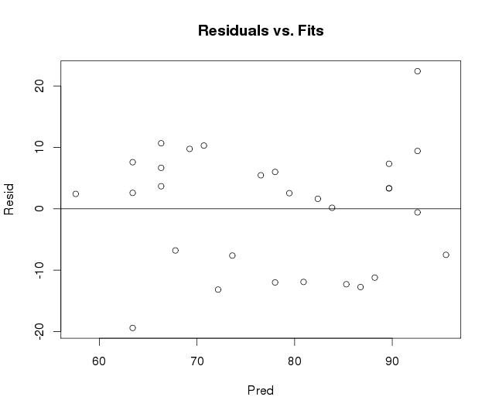
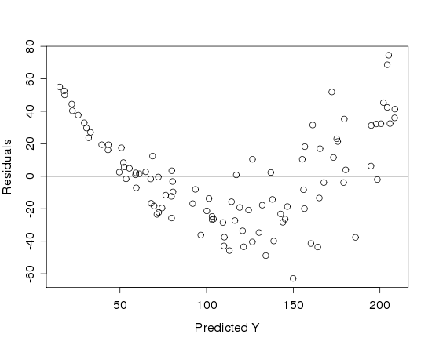

Is it Linear?
Plot the residuals vs. the predictions

Slide 8
Simple Linear Model- Conditions
Model:
Linearity: The means for Y vary as a linear function of X.
Error:
Zero Mean: The distribution of the errors is centered at zero.
Constant variance: The variance for Y is the same at each X. (Homoscedasticity)
Independence: No relationships among errors.
Normality:
Residuals are normally distributed
(sometimes) At each X, the Y’s follow a normal distribution.

Slide 9
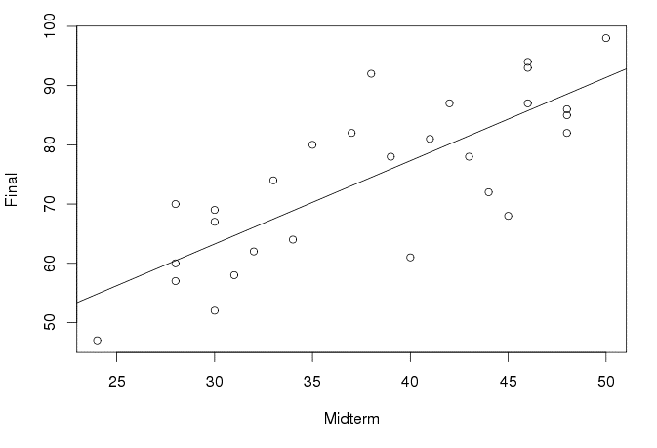
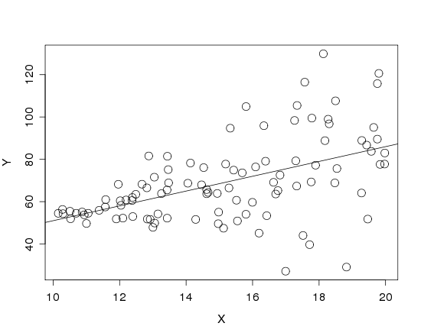
Is the Variance Constant?
Look at a scatterplot with the regression line drawn on it.
Look for “fan-shaped” pattern

Slide 10
Simple Linear Model- Conditions
Model:
Linearity: The means for Y vary as a linear function of X.
Error:
Constant variance: The variance for Y is the same at each X. (Homoscedasticity)
Independence: No relationships among errors.
Normality:
Residuals are normally distributed
(sometimes) At each X, the Y’s follow a normal distribution.

Slide 11
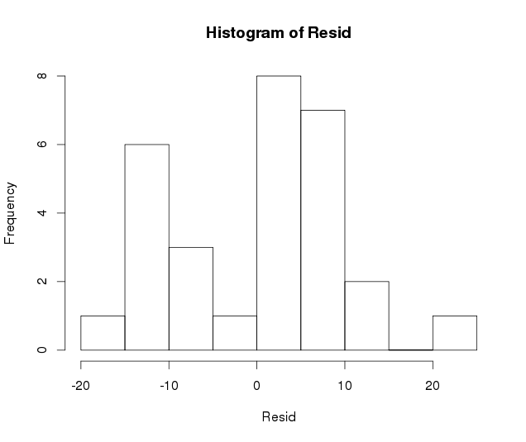
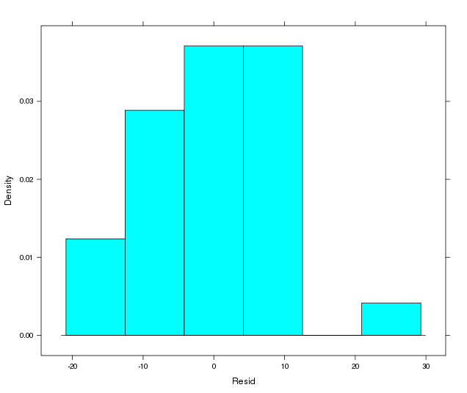
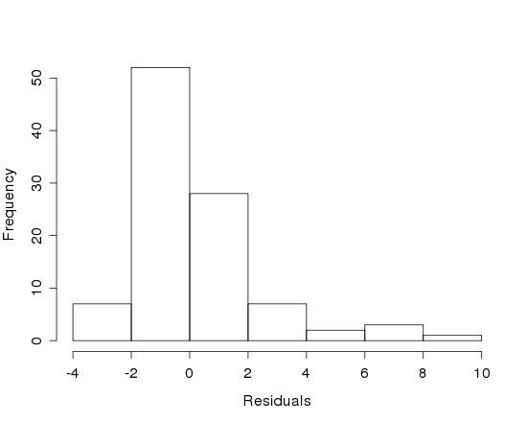
Are the Residuals Normal?
Look at a histogram of the residuals
?
Look for clear skewness and outliers

Slide 12
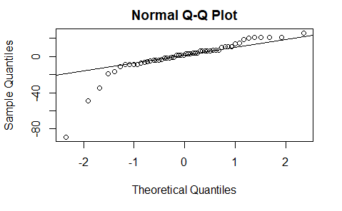
Are the Residuals Normal?
qqnorm(mod1$residuals)
qqline(mod1$residuals)

Slide 13
Simple Linear Model- Conditions
Model:
Linearity: The means for Y vary as a linear function of X.
Error:
Constant variance: The variance for Y is the same at each X. (Homoscedasticity)
Normality:
Residuals are normally distributed
(sometimes) At each X, the Y’s follow a normal distribution.

Slide 14
What to do when regression assumptions are violated?
Examples:
Nonlinear patterns in residuals
Heteroscedasticity (nonconstant variance)
Lack of normality in residuals
Outliers: influential points, large residuals

Slide 15
Data Transformations
Can be used to:
Address non-linear patterns
Stabilize variance
Remove skewness from residuals
Minimize effects of outliers

Slide 16





Common Transformations
For either the response (Y) or predictor (X)...
Logarithm
$$Y→log⁡(Y)$$
Square root
$$Y→\sqrt{Y}$$
Exponentiation
$$Y→e^{Y}$$
Power function
$$Y→Y^{3}$$
Reciprocal
$$Y→1/Y$$

Slide 17
Example: Planets
Y = Length of the “year” for planets
X = Distance from the sun
Try scatterplots and LM with
Year vs. Distance
log(Year) vs. Distance
Year vs. log(Distance)
log(Year) vs. log(Distance)
Which transformation gives the best linearity?

Slide 18
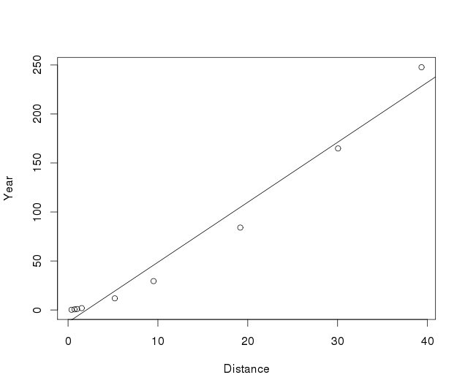
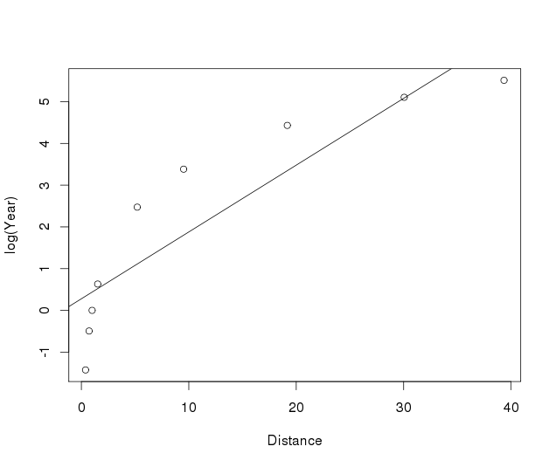
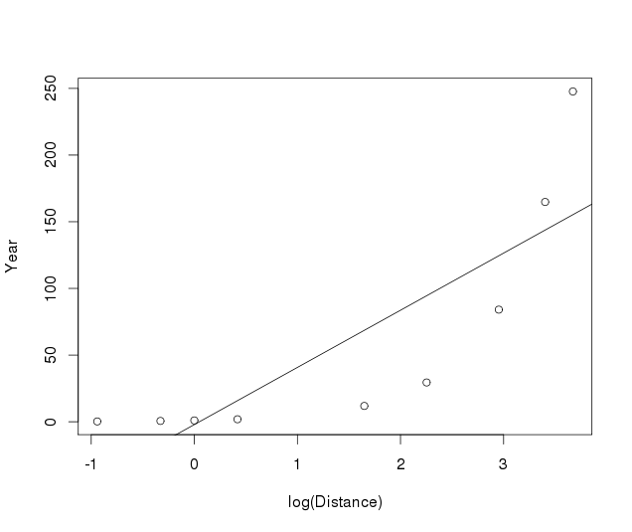
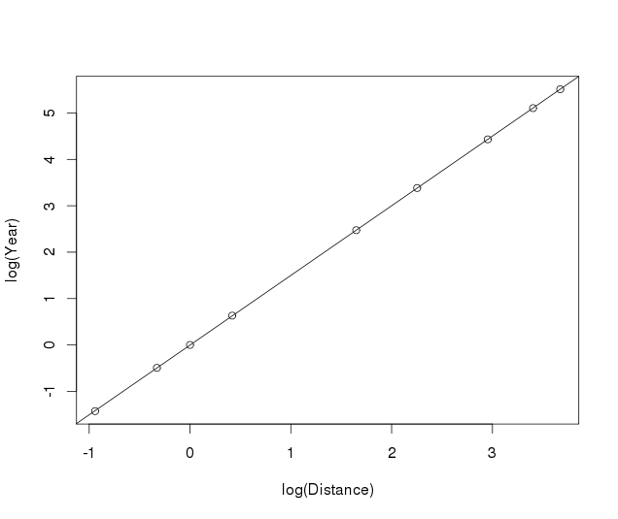
Planet Transformations

Slide 19

Fitting the Planet Model
$$log⁡(Year)=β_{0}+{β }_{1}log⁡(Distance)+ε$$
Call:
lm(formula = log(Year) ~ log(Distance), data = Planets)
Coefficients:
(Intercept) log(Distance)
-0.003434 1.502061
$$\hat{log⁡(Year)}=−0.00343+1.502∙log⁡(Distance)$$
“Exponentiate”
$$\hat{Year}=e^{−0.00343+1.502log⁡(Distance)}$$
$$={0.997∙Distance}^{1.502}$$

Slide 20
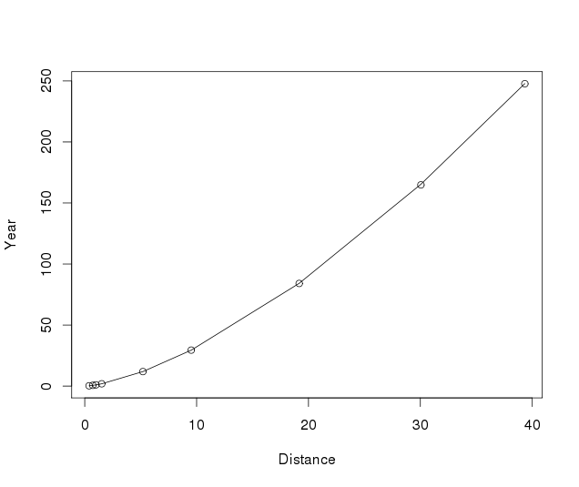
Fitting the Planet Model
plot(Year~Distance,data=Planets)
curve(0.996566*(x^1.5020611), add=TRUE)

Slide 21
Example: Mammal Species
Y = Number of mammal species on an island
X = Area of the island
Data on fourteen islands in Southeast Asia are stored in SpeciesArea (in Stats2Data)
data(SpeciesArea)
head(SpeciesArea)
Name Area Species logArea logSpecies
1 Borneo 743244 129 13.51880 4.85981
2 Sumatra 473607 126 13.06810 4.83628
3 Java 125628 78 11.74110 4.35671
4 Bangka 11964 38 9.38966 3.63759
5 Bunguran 1594 24 7.37400 3.17805
6 Banggi 450 18 6.10925 2.89037

Slide 22
